Slide 1

CEF440 · TASK 6 · GROUP 15
Adaptive E-Learning Platform
Design and Implementation of an Adaptive E-Learning Platform Based on Quality of Experience for Inclusive Online Education in Low-Resource Settings
University of Buea · Faculty of Engineering & Technology · Department of Computer Engineering
Course Instructor: Dr Nkemeni Valery · 15th June 2026

Slide 2
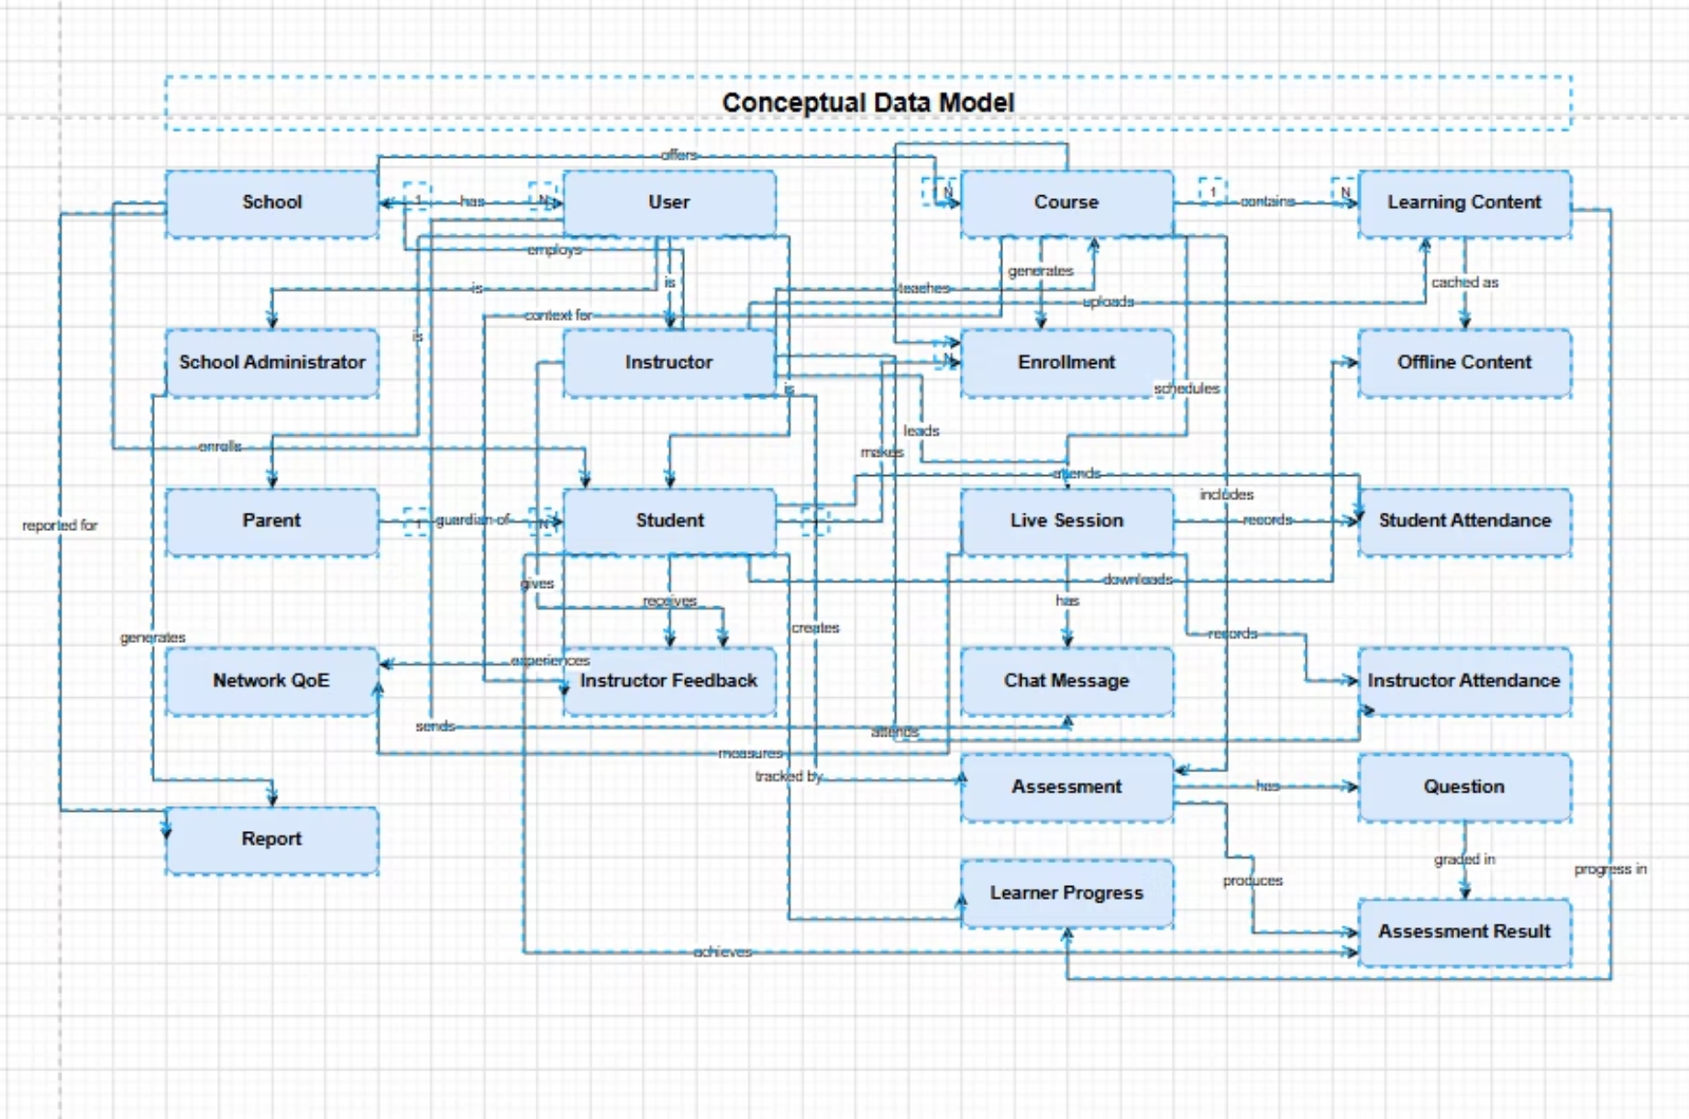
INTRODUCTION
System Overview
Learn Bridge is an adaptive e-learning platform for low-resource settings. The database, backend, and frontend work together as one system — the frontend displays the UI while the backend processes requests and communicates with the database.
PostgreSQL
Prisma ORM
Node.js + Express
JWT + bcryptjs
Relational database
Database access layer
Backend API
Auth & hashing

Slide 3

DATA ELEMENTS
User, Course & Lesson Entities
User
Course
Lesson
Stores all registered users — learner, instructor, parent, or admin. Fields: UserID, name, email (unique), hashed password, role, avatar URL, timestamps. Role determines system access.
Course details: CourseID, title, description, category, level, price, published status, instructor ID. Linked to lessons, quizzes, enrollments, and progress.
Learning content within a course: LessonID, title, content, video URL, order, duration, course ID. Order ensures correct content sequence.

Slide 4
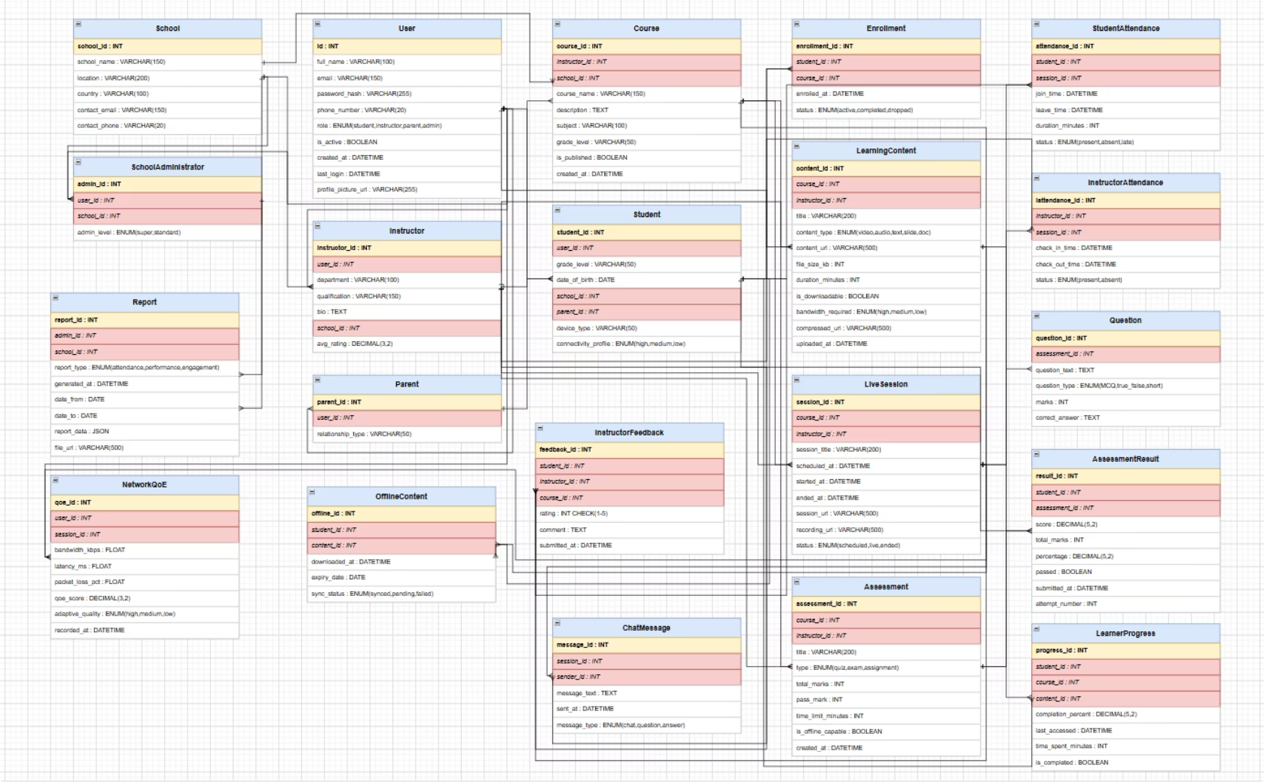
DATA ELEMENTS
Enrollment, Progress & Quiz Entities
Enrollment
Connects learners to courses (many-to-many). Fields: EnrollmentID, learner ID, course ID, enrolled date. Unique constraint on [learnerId, courseId] prevents duplicates.
Progress
Tracks lesson completion: ProgressID, learner ID, course ID, lesson ID, isCompleted, completedAt. Enables dashboard progress and learning percentage calculations.
Quiz & Question
Quizzes attached to courses; questions store text, options (JSON), correct answer, points. Quiz results track scores, submitted answers, and timestamps.
Parent-Child
Links parent accounts to child learner accounts, enabling parents to monitor learning progress.

Slide 5





CONCEPTUAL DESIGN
System Layers
The conceptual design defines the high-level structure, identifying main entities and relationships before implementation details.
Institutional Layer
User Layer
Learning Process Layer
School, School Administrator, Parent — oversight, accountability, and supervision.
User generalized into Student and Instructor with role-based access control.
Course, Enrollment, Learning Content, Offline Content, Live Session — multimedia, offline access, live interaction.
Assessment & Progress Layer
Quality & Reporting Layer
Assessment, Results, Learner Progress, Attendance, Instructor Feedback — quizzes and parental monitoring.
Network QoE monitors connectivity; Reports provide attendance, progress, and performance analytics for parents and admins.

Slide 6

ER DIAGRAM
Logical Database Schema
Key Entity Groups
Institutional: School → School Administrator → Report
Users: User (Student / Instructor) with role-based access
Learning: Course → Enrollment → Learning Content → Offline Content → Live Session → Chat Message
Assessment: Assessment → Question → Answer Result → Learning Progress → Report
Quality: NetworkQoC monitors bandwidth, latency, packet loss for adaptive delivery

Slide 7
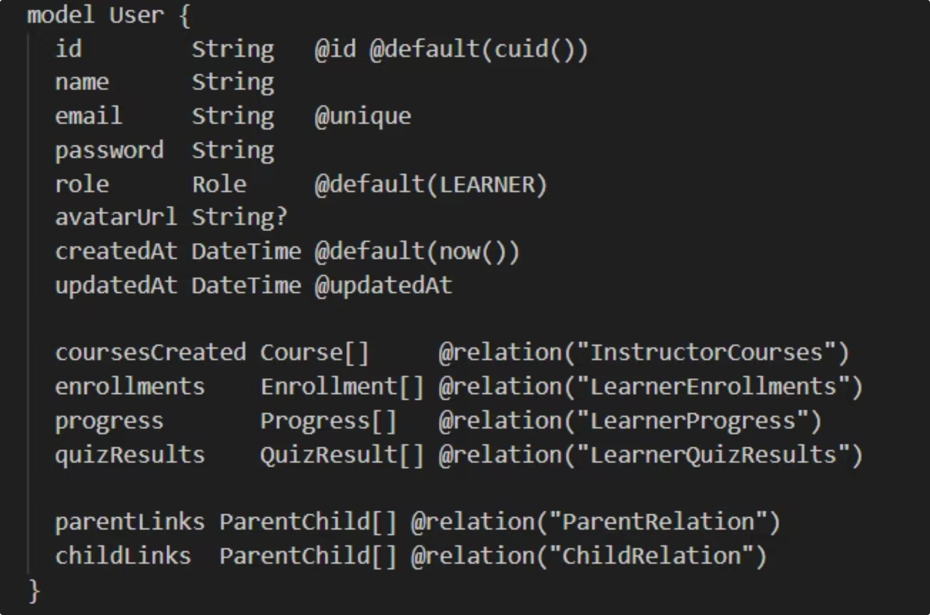
DATABASE IMPLEMENTATION
PostgreSQL & Prisma Setup
Database Creation
A database named learnbridge was created in PostgreSQL. The backend connects via a connection string in the .env file (host: localhost, port: 5432).
Key Constraints
email String @unique — prevents duplicate emails
@@unique([learnerId, courseId]) — prevents duplicate enrollments
@@unique([learnerId, lessonId]) — one progress record per lesson
Cascade delete on course → lessons for consistency
Tables created via npx prisma migrate dev. Seed file populated test accounts, a sample course, lessons, quiz, and enrollment.

Slide 8
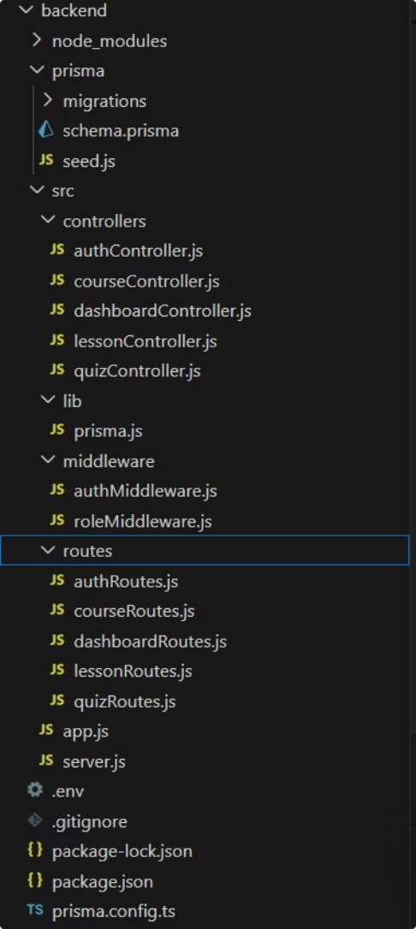
BACKEND IMPLEMENTATION
Node.js + Express API
Folder Structure
Organised into routes (endpoints), controllers (business logic), middleware (auth), and lib/prisma.js (DB connection). Server runs on http://localhost:5000.
Authentication
Passwords hashed with bcryptjs (12 rounds). On login, JWT token issued (expires 7 days). Frontend sends Authorization: Bearer token on protected routes.
Auth Routes
Course Routes
Lesson Routes
POST /register, /login · GET /me
GET /courses · POST /:id/enroll
GET /:id · POST /:id/complete
Quiz Routes
Dashboard
GET /:id · POST /:id/submit
GET /dashboard/learner

Slide 9
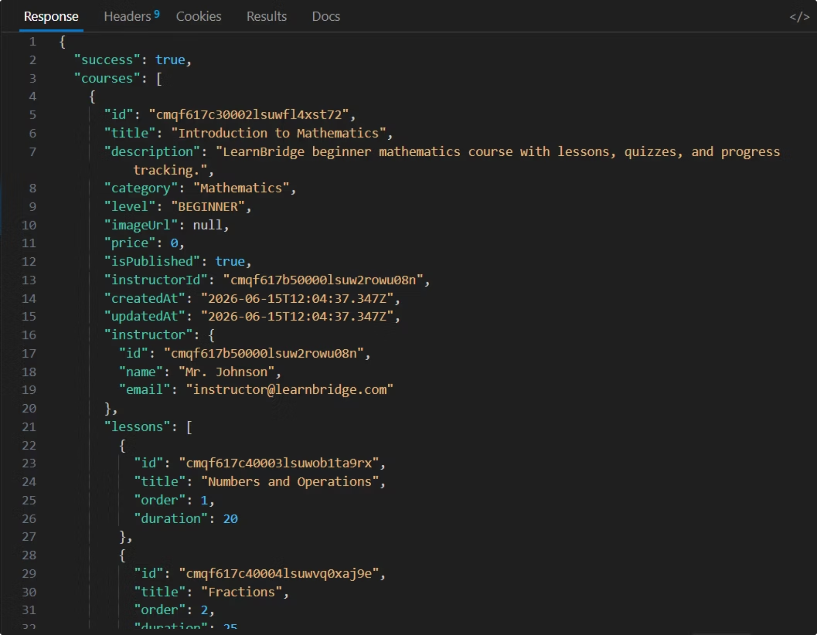

TESTING
API Testing Results
Tests Performed
Health Check — GET /api/health returned success
Login — POST /api/auth/login returned JWT token
Courses — GET /api/courses returned published courses with instructor, lessons, and enrollment counts
Dashboard — GET /api/dashboard/learner returned total courses, lessons, completed lessons, progress %, and recent quiz results
All routes required Authorization: Bearer token header. The dashboard test confirmed correct data aggregation from the database.

Slide 10



CONCLUSION
Challenges & Conclusion
Challenges Encountered
Conclusion
The LearnBridge database design and implementation successfully provides a structured, relational system for managing users, courses, lessons, enrollments, progress, quizzes, and results.
PostgreSQL, Prisma ORM, and Express.js were integrated effectively. The backend connects to the database via Prisma Client, and all API routes were tested and verified.
PostgreSQL Installation
Initially not installed; resolved by installing PostgreSQL and creating the learnbridge database.
Prisma Configuration
Errors when Prisma could not find the database URL or schema file. Fixed by setting the connection correctly and running commands from the backend directory.
Auth Header
Protected routes required Authorization: Bearer token. Missing Bearer prefix caused unauthorised errors.

